Slide 1

TOPIC- Introduction to computer
COURSE: CCC Concept
CHAPTER: 01 (Introduction to computer)
DAY: 02
NIELIT
Presentation By : Anjali Dhingan

Slide 2
Evolution of Computer
The first modern computer was created in the 1930s and was called the Z1, which was followed by large machinery that took up entire rooms. In the '60s, computers evolved from professional use to personal use, as the first personal computer was introduced to the public.
पहला आधुनिक कंप्यूटर 1930 के दशक में बनाया गया था और इसे Z1 कहा जाता था, जिसके बाद पूरे कमरे में बड़ी मशीनरी लगी। 60 के दशक में, कंप्यूटर पेशेवर उपयोग से व्यक्तिगत उपयोग के रूप में विकसित हुए, क्योंकि पहला व्यक्तिगत कंप्यूटर सार्वजनिक रूप से पेश किया गया था।

Slide 3
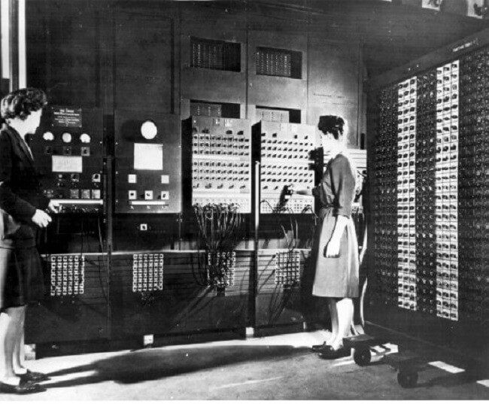
Generation of Computer
First Generation Of Computer: Vacuum Tubes (1940–1956)

Slide 4
First Generation Of Computer: Vacuum Tubes (1940–1956)
The first generation of the computer used vacuum tubes for the circuitry and the magnetic drums for the memory and taking up the big rooms. It was very expensive to operate and uses a great amount of electricity and produced a large amount of heat. The first generation of the computer relied on the machine language, the lowest level programming language which was understood by the computers to perform the various functions and operations. It can solve the one problem at a time can’t do the multitasking work. The input was based on the punched cards and the paper tape and the output was displayed on the printouts. ENIAC and UNIVAC are examples of the first generation of the computer. The first commercial computer was UNIVAC which was delivered to the business client.

Slide 5
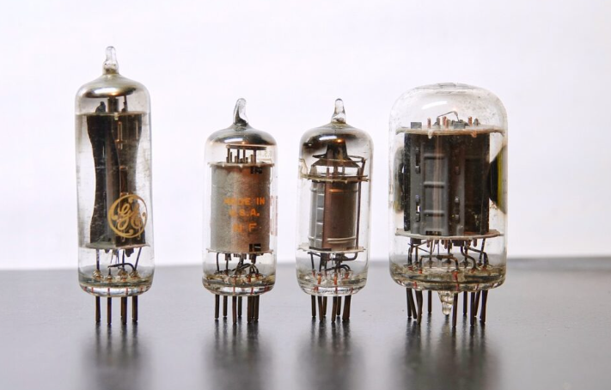
Vacuum Tube

Slide 6
First Generation Of Computer: Vacuum Tubes (1940–1956)
The first general-purpose programmable electronic computer was the ENIAC (Electronic Numerical Integrator and Computer), built by”J Presper Eckert and John V Mauchly at the University of Pennsylvania. The ENIAC was 30-50 feet long, 30 tons weighted, contained 18000 vacuum tubes, 70000 registers, and 10000 capacitors, and it required 150000 watts of electricity, which makes it very expensive.
Later, Ekart and Mauchly developed the first commercially successful computer name UNIVAC(Univeral Automatic Computer) in 1952.

Slide 7
First Generation Of Computer: Vacuum Tubes (1940–1956)
कंप्यूटर की पहली पीढ़ी ने सर्किटरी और चुंबकीय ड्रम के लिए मेमोरी और बड़े कमरों को लेने के लिए वैक्यूम ट्यूब का इस्तेमाल किया। यह बड़ी मात्रा में बिजली का संचालन और उपयोग करने के लिए बहुत महंगा था और बड़ी मात्रा में गर्मी का उत्पादन किया। कंप्यूटर की पहली पीढ़ी मशीन भाषा पर भरोसा करती है, निम्नतम स्तर की प्रोग्रामिंग भाषा जिसे कंप्यूटर द्वारा विभिन्न कार्यों और संचालन को समझने के लिए समझा जाता था। यह एक समय में एक समस्या को हल कर सकता है। यह मल्टीटास्किंग कार्य नहीं कर सकता है। इनपुट छिद्रित कार्ड और पेपर टेप पर आधारित था और आउटपुट प्रिंटआउट पर प्रदर्शित किया गया था। ENIAC और UNIVAC कंप्यूटर की पहली पीढ़ी के उदाहरण हैं। पहला व्यावसायिक कंप्यूटर UNIVAC था जिसे व्यावसायिक ग्राहक तक पहुंचाया गया था।

Slide 8
First Generation Of Computer: Vacuum Tubes (1940–1956)
Advantages Of The First Generation Of The Computer
These computers were designed by using vacuum tubes.
These generations’ computers were simple architecture.
These computers calculate data in a millisecond.
This computer is used for scientific purposes
Disadvantages Of The First Generation Of The Computer
The computer was very costly.
Very large in size.
It takes up a lot of space and electricity
It is used for commercial purposes.
It is very expensive.
These computers heat a lot.
Cooling is needed to operate these computers because it heats up very quickly.

Slide 9
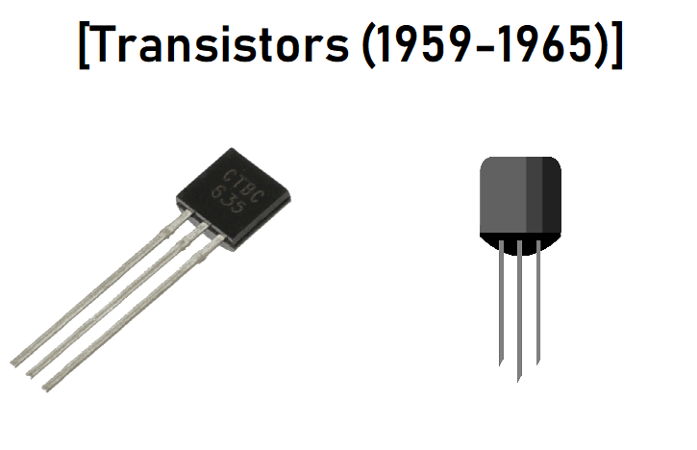
Second Generation Of Computer: Transistors (1956–1963)
Transistors were used in the second generation of the computer and transistors replaced the vacuum tubes. The first transistor was invented in 1947 but didn’t use in the computer till 1950. Transistors are superior to the vacuum tube because due to the transistors computer becomes smaller, cheaper and faster. It is very reliable than the first generation of the computer. Transistors were also produced the large amount of heat that subjected the computer to damage. But some improvement was shown that in the second generation of the computer. The input was based on the punched cards and paper tapes and outputs were displayed on the printouts which were the same as the first generation of computer. The second generation of computer moved to the symbolic or assembly language from the cryptic binary machine language. This language allowed the programmers to specify the input or instructions in words. High-level programming languages were also developed at the same time. The first computer of the second generation was developed for the atomic energy industry.
A transistor is a semiconductor device used to amplify or switch electronic signals or opens or close a circuit. It is invented in bell labs, The transistors become the key ingredient of all digital circuits, including computers.

Slide 10
Second Generation Of Computer: Transistors (1956–1963)
कंप्यूटर की दूसरी पीढ़ी में ट्रांजिस्टर का उपयोग किया गया था और ट्रांजिस्टर ने वैक्यूम ट्यूबों को बदल दिया। पहला ट्रांजिस्टर 1947 में आविष्कार किया गया था लेकिन 1950 तक कंप्यूटर में इसका उपयोग नहीं किया गया था। ट्रांजिस्टर वैक्यूम ट्यूब से बेहतर हैं क्योंकि ट्रांजिस्टर के कारण कंप्यूटर छोटा, सस्ता और तेज हो जाता है। यह कंप्यूटर की पहली पीढ़ी की तुलना में बहुत विश्वसनीय है। ट्रांजिस्टर भी बड़ी मात्रा में गर्मी का उत्पादन करते थे जो कंप्यूटर को नुकसान पहुंचाते थे। लेकिन कुछ सुधार दिखाया गया था कि कंप्यूटर की दूसरी पीढ़ी में। इनपुट छिद्रित कार्ड और पेपर टेप पर आधारित था और प्रिंटआउट पर आउटपुट प्रदर्शित किए गए थे जो कंप्यूटर की पहली पीढ़ी के समान थे। कंप्यूटर की दूसरी पीढ़ी क्रिप्टिक बाइनरी मशीन भाषा से प्रतीकात्मक या असेंबली भाषा में चली गई। इस भाषा ने प्रोग्रामर को शब्दों में इनपुट या निर्देशों को निर्दिष्ट करने की अनुमति दी। उच्च-स्तरीय प्रोग्रामिंग भाषाओं को भी उसी समय विकसित किया गया था। दूसरी पीढ़ी का पहला कंप्यूटर परमाणु ऊर्जा उद्योग के लिए विकसित किया गया था।

Slide 11
Second Generation Of Computer: Transistors (1956–1963)
The second-generation computer has a high level of programming languages, including FORTRAN (1956), ALGOL(1958), and COBOL(1959).
Examples are PDP-8(Programmed Data Processor-8), IBM1400(International business machine 1400 series), IBM 7090(International business machine 7090 series), CDC 3600( Control Data Corporation 3600 series)

Slide 12
Second Generation Of Computer: Transistors (1956–1963)
Advantages Of The Second Generation Of The Computer
It is smaller in size as compared to the first-generation computer
It used a less electricity
Not heated as much as the first-generation computer.
It has better speed
Also used assembly language
Disadvantages Of The Second Generation Of The Computer
It is also costly and not versatile
still, it is expensive for commercial purposes
Cooling is still needed
Punch cards were used for input
The computer is used for the particular purpose

Slide 13
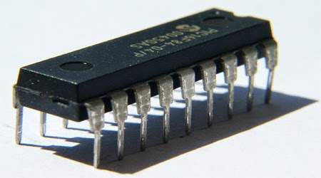
Third Generation Of The Computer: Integrated Circuits (1964–1971)
The third generation of computers is characterized by the use of “Integrated Circuits” it was developed in 1958 by “Jack Kilby”. The integrated circuit is a set of electronic circuits on small flat pieces of semiconductor that is normally known as silicon. The transistors were miniaturized and placed on silicon chips which are called semiconductors, which drastically increased the efficiency and speed of the computers.
These ICs (integrated circuits) are popularly known as chips. A single IC, has many transistors, resistors, and capacitors built on a single slice of silicon.
This development made computers smaller in size, low cost, large memory, and processing. The speed of these computers is very high and it is efficient and reliable also.

Slide 14
Third Generation Of The Computer: Integrated Circuits (1964–1971)
These generations of computers have a higher level of languages such as Pascal PL/1, FORTON-II to V, COBOL, ALGOL-68, and BASIC(Beginners All-purpose Symbolic Instruction Code) was developed during these periods.
Examples are NCR 395(National Cash Register), IBM 360,370 series, B6500

Slide 15
Third Generation Of The Computer: Integrated Circuits (1964–1971)
कंप्यूटर की तीसरी पीढ़ी में एकीकृत सर्किट का उपयोग किया गया था। ट्रांजिस्टर को सिलिकॉन चिप्स पर रखा गया था जिसे अर्धचालक के रूप में जाना जाता है जो कंप्यूटर की गति और दक्षता को काफी बढ़ाता है। तीसरी पीढ़ी के कंप्यूटर उपयोगकर्ता ने कीबोर्ड और मॉनिटर का उपयोग किया और छिद्रित कार्ड और प्रिंटआउट के बजाय एक ओएस (ऑपरेटिंग सिस्टम) के साथ हस्तक्षेप किया। इस पीढ़ी में, कंप्यूटर एक समय में कई एप्लिकेशन चला सकता है। कंप्यूटर की यह पीढ़ी अपने पूर्ववर्तियों की तुलना में छोटी, सस्ती और विश्वसनीय है।

Slide 16
Third Generation Of The Computer: Integrated Circuits (1964–1971)
Advantages Of The Third Generation Of The Computer
These computers are smaller in size as compared to previous generations
It consumed less energy and was more reliable
More Versatile
It produced less heat as compared to previous generations
These computers are used for commercial and as well as general-purpose
These computers used a fan for head discharge to prevent damage
This generation of computers has increased the storage capacity of computers
Disadvantages Of The Third Generation Of The Computer
Still, a cooling system is needed.
It is still very costly
Sophisticated Technology is required to manufacture Integrated Circuits
It is not easy to maintain the IC chips.

Slide 17
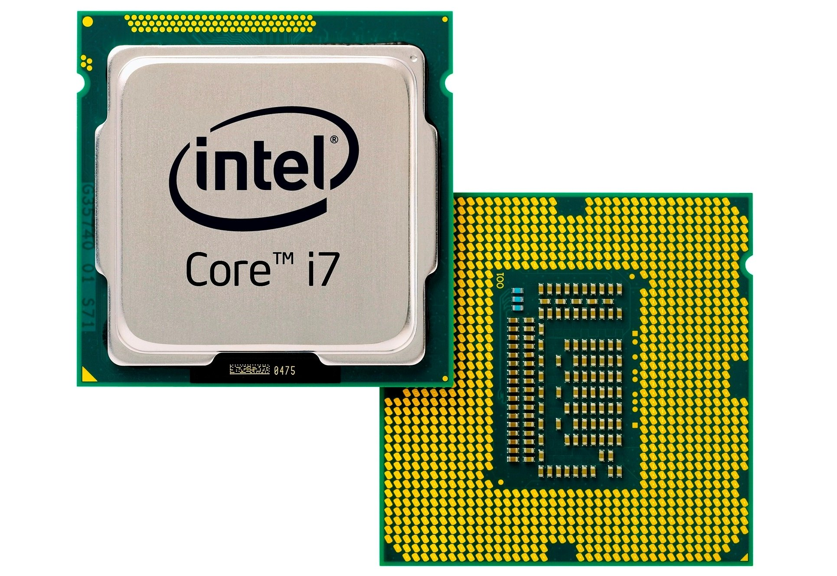
Fourth Generation Of Computer: Microprocessors (1971–2010)
The microprocessor brought in the fourth generation of computers. Thousands of the integrated circuits were built on the single silicon chip. The first generation of computer occupies the entire room but now the fourth generation of computer fit in the palm of the hand. In 1971 Intel 4004 chips were developed which was located to all the components of the computer. IBM introduced its first computer for home users in 1981. The fourth generation of the computer became more powerful and could be linked together to form the networks which led to internet development. In the fourth generation of computer, we saw the development of the GUIs, keyboard, mouse and other hand handled devices.

Slide 18
Fourth Generation Of Computer: Microprocessors (1971–2010)
माइक्रोप्रोसेसर कंप्यूटर की चौथी पीढ़ी में लाया गया। सिंगल सिलिकॉन चिप पर हजारों एकीकृत सर्किट बनाए गए थे। कंप्यूटर की पहली पीढ़ी पूरे कमरे में रहती है लेकिन अब कंप्यूटर की चौथी पीढ़ी हाथ की हथेली में फिट होती है। 1971 में इंटेल 4004 चिप्स विकसित किए गए थे जो कंप्यूटर के सभी घटकों के लिए स्थित थे। आईबीएम ने 1981 में घर उपयोगकर्ताओं के लिए अपना पहला कंप्यूटर पेश किया। कंप्यूटर की चौथी पीढ़ी अधिक शक्तिशाली बन गई और इसे नेटवर्क बनाने के लिए एक साथ जोड़ा जा सकता है जिससे इंटरनेट का विकास हुआ। कंप्यूटर की चौथी पीढ़ी में, हमने GUI, कीबोर्ड, माउस और अन्य हाथ से चलने वाले उपकरणों के विकास को देखा।

Slide 19
Fourth Generation Of Computer: Microprocessors (1971–2010)
Advantages Of The Fourth Generation Of The Computer
These computers are smaller in size and much more reliable as compared to other generations of computers.
The heating issue on these computers is almost negligible
No A/C or Air conditioner is required in a fourth-generation computer.
In these computers, all types of higher languages can be used in this generation
It is totally also for the general-purpose
less expensive
These computers are cheaper and also portable
Disadvantages Of The Fourth Generation Of The Computer
Fans are required to operate these kinds of computers
It required the latest technology for the need of making microprocessors and complex software
These computers were highly sophisticated
It also required advanced technology to make the ICs(Integrated circuits)

Slide 20
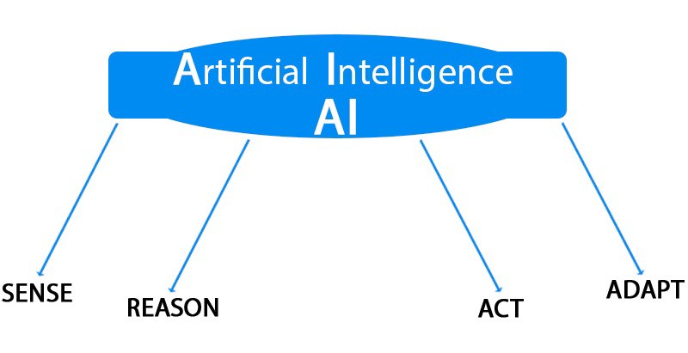
Fifth Generation Of Computer: Artificial Intelligence (2010 — Present)
These generations of computers were based on AI(Artificial Intelligence) technology. Artificial technology is the branch of computer science concerned with making computers behave like humans and allowing the computer to take its own decision currently, no computers exhibit full artificial intelligence (that is, are able to simulate human behavior).

Slide 21
In the fifth generation of computers, VLSI technology and ULSI(Ultra Large Scale Integration)
technology are used and the speed of these computers is extremely high.
This generation introduced machines with hundreds of processors that could all be working on differentparts of a single program.
The development of a more powerful computer is still in progress. It has been predicted that such a computer will be able to communicate in natural spoken languages with its user.In this generation, computers are also required to use a high level of languages like C language, c++, java, etc.

Slide 22
Fifth Generation Of Computer: Artificial Intelligence (2010 — Present)
कंप्यूटर की पांचवीं पीढ़ी कृत्रिम बुद्धिमत्ता और अभी भी विकास पर आधारित है। कई अनुप्रयोग हैं जो इस पीढ़ी में उपयोग किए जाते हैं जैसे ध्वनि मान्यता जो आज उपयोग की जा रही है। सुपरकंडक्टर्स और समानांतर प्रसंस्करण का उपयोग एआई को वास्तविकता बनाने में मदद करता है। इस पीढ़ी का लक्ष्य या लक्ष्य प्राकृतिक भाषाओं पर प्रतिक्रिया देने वाले उपकरणों को विकसित करना है।

Slide 23
Fifth Generation Of Computer: Artificial Intelligence (2010 — Present)
Advantages Of The Fifth Generation Of The Computer
More reliable and faster than its predecessor.
Easily available in different sizes with unique and different features.
Disadvantages Of The Fifth Generation Of The Computer
Disadvantages of the fifth generation of the computer have yet to be agreed upon.

Slide 24
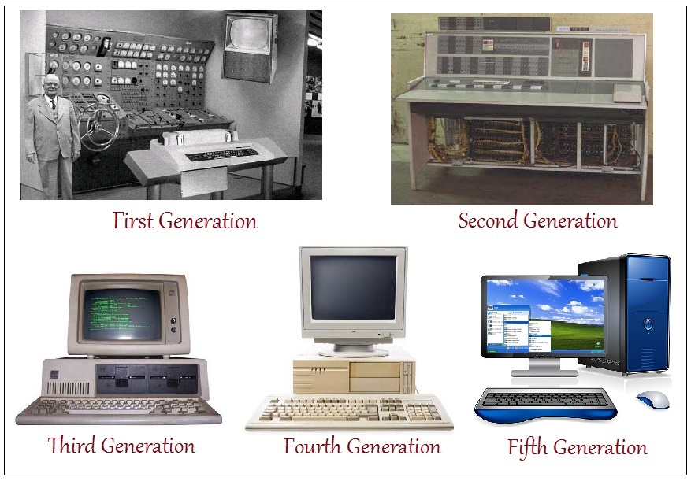
Generation of computers

Slide 25
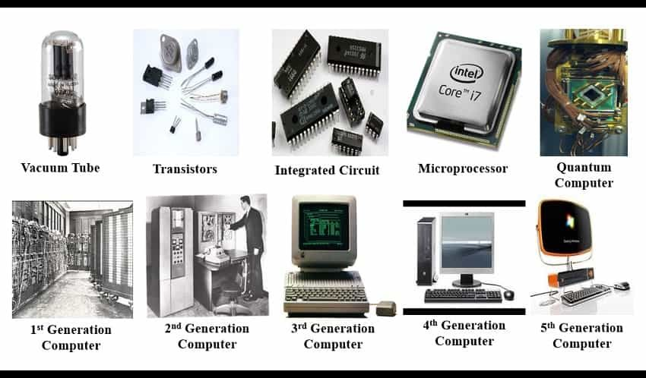
Generation of computers

Slide 26
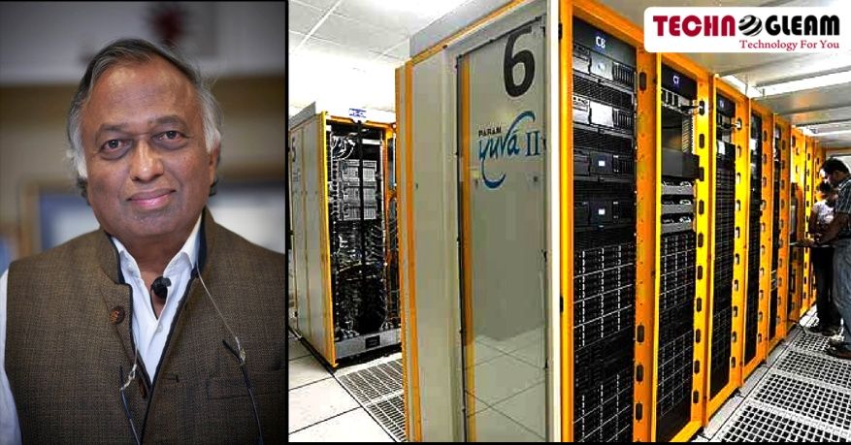
On the basis of size, the computer can be of five types:
1. Supercomputer
Supercomputers are the biggest and fastest computers. They are designed to process huge amount of data. A supercomputer can process trillions of instructions in a second. It has thousands of interconnected processors.
Supercomputers are particularly used in scientific and engineering applications such as weather forecasting, scientific simulations and nuclear energy research. The first supercomputer was developed by Roger Cray in 1976.

Slide 27
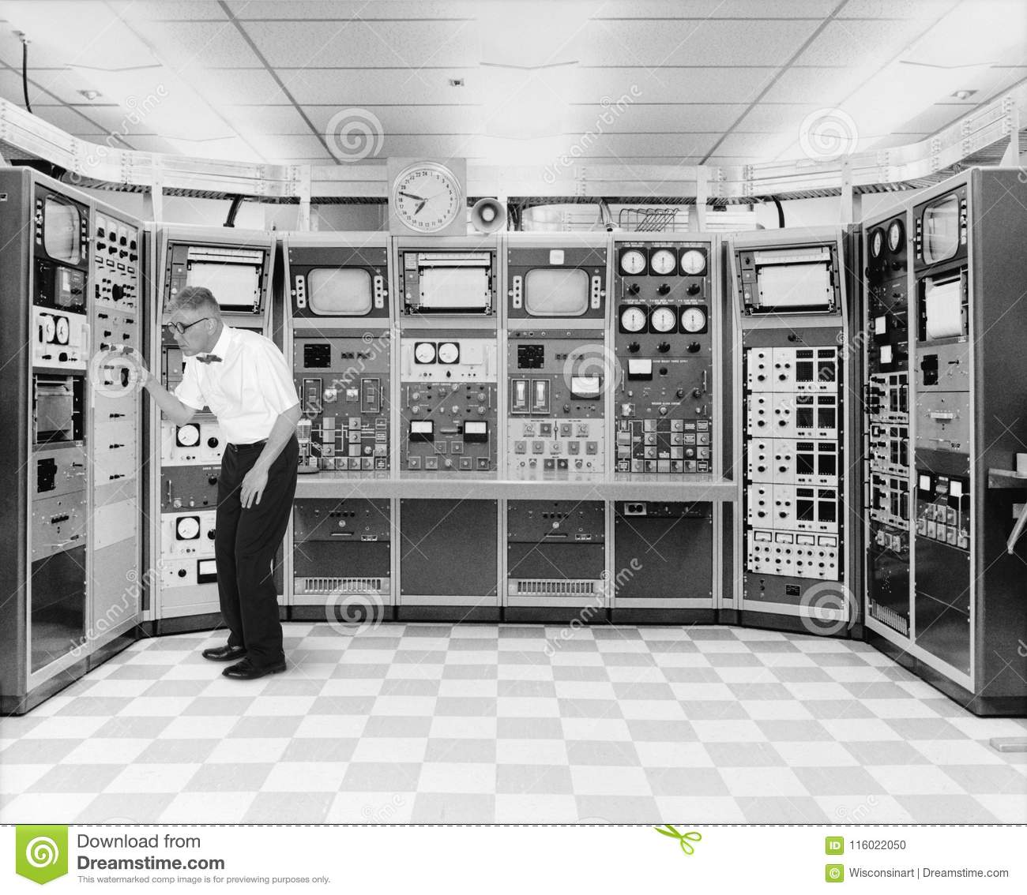
2. Mainframe computer
Mainframe computers are designed to support hundreds or thousands of users simultaneously. They can support multiple programs at the same time. It means they can execute different processes simultaneously. These features of mainframe computers make them ideal for big organizations like banking and telecom sectors, which need to manage and process high volume of data that requires integer operations such as indexing, comparisons, etc

Slide 28
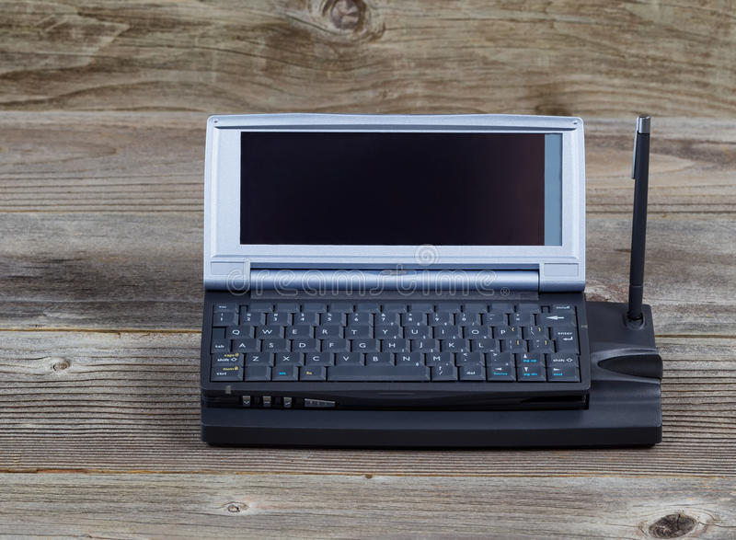
3. Miniframe or Minicomputer
It is a midsize multiprocessing computer. It consists of two or more processors and can support 4 to 200 users at one time. Miniframe computers are used in institutes and departments for tasks such as billing, accounting and inventory management. A minicomputer lies between the mainframe and microcomputer as it is smaller than mainframe but larger than a microcomputer

Slide 29
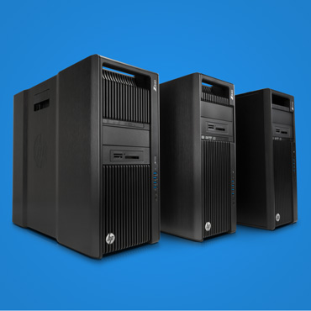
4. Workstation
Workstation is a single user computer that is designed for technical or scientific applications. It has a faster microprocessor, a large amount of RAM and high speed graphic adapters. It generally performs a specific job with great expertise; accordingly, they are of different types such as graphics workstation, music workstation and engineering design workstation

Slide 30
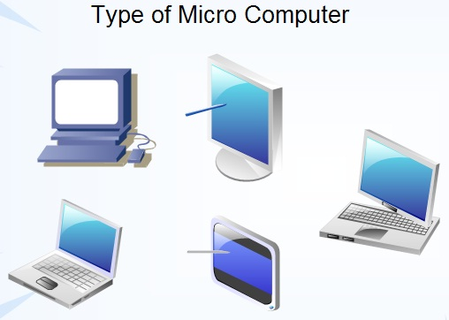
5. Microcomputer
Microcomputer is also known as a personal computer. It is a general-purpose computer that is designed for individual use. It has a microprocessor as a central processing unit, memory, storage area, input unit and output unit. Laptops and desktop computers are examples of microcomputers. They are suitable for personal work that may be making an assignment, watching a movie, or at office for office work.

Slide 31
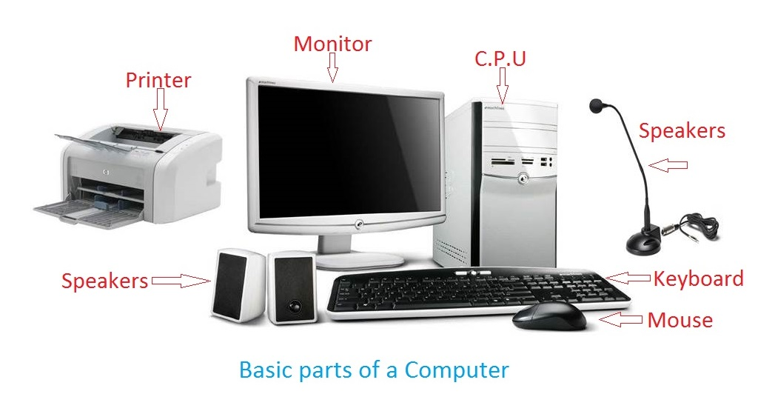
Basic Parts of Computer

Slide 32
Basic Parts of Computer
The essential components of the computer can be defined as follows:
Input Unit: Input Units or devices are used to input the data or instructions into the computers. Some most common input devices are mouse and keyword.
Output Unit: Output Units or devices are used to provide output to the user in the desired format. The most popular examples of output devices are the monitor and the printer.
Control Unit: As its name states, this unit is primarily used to control all the computer functions and functionalities. All the components or devices attached to a computer interact with each other through the control unit. In short, the control unit is referred to as 'CU'.
Arithmetic Logic Unit: The arithmetic logic unit helps perform all the computer system's arithmetic and logical operations. In short, the arithmetic logic unit is referred to as 'ALU'.
Memory: Memory is used to store all the input data, instructions, and output data. Memory usually has two types: Primary Memory and Secondary Memory. The memory found inside the CPU is called the primary memory, whereas the memory that is not the integral part of the CPU is called secondary memory.

Slide 33
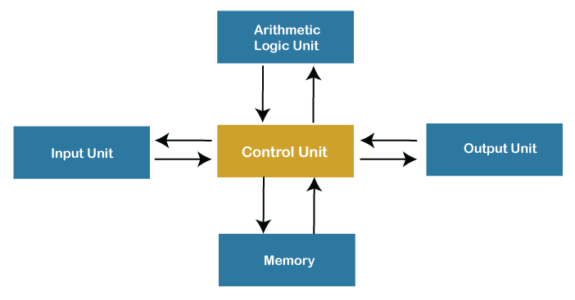
Basic Parts of Computer
Note: Control Unit, arithmetic logic unit, and the memory simultaneously form the central processing unit (called CPU in short).

Slide 34
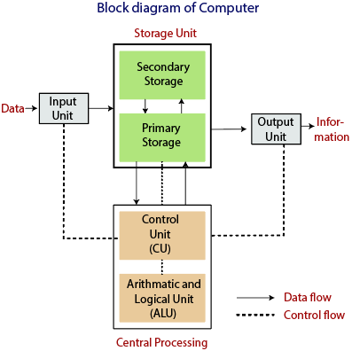
Central Processing Unit (CPU)

Slide 35
Functions of Computer
1) Inputting: It is the process of entering raw data, instructions and information into the computer. It is performed with the help of input devices.
2) Storing: The computer has primary memory and secondary storage to store data and instructions. It stores the data before sending it to CPU for processing and also stores the processed data before displaying it as output dling in Java – Java point
3) Processing: It is the process of converting the raw data into useful information. This process is performed by the CPU of the computer. It takes the raw data from storage, processes it and then sends back the processed data to storage.
4) Outputting: It is the process of presenting the processed data through output devices like monitor, printer and speakers.
5) Controlling: This operation is performed by the control unit that is part of CPU. The control unit ensures that all basic operations are executed in a right manner and sequence.

Slide 36
Uses of Computer
Business
Education
Healthcare
Retail and Trade
Government
Marketing
Science
Publishing
Arts and Entertainment
Communication
Banking and Finance
Transport
Navigation
Working From Home
Military
Social
Booking Vacations
Security and Surveillance
Weather Forecasting
Robotics
व्यापार
शिक्षा
स्वास्थ्य देखभाल
खुदरा और व्यापार
सरकार
विपणन
विज्ञान
प्रकाशन
कला और मनोरंजन
संचार
बैंकिंग व वित्त
ट्रांसपोर्ट
पथ प्रदर्शन
घर से काम करना
सैन्य
सामाजिक
बुकिंग की छुट्टियां
सुरक्षा और निगरानी
मौसम की भविष्यवाणी
रोबोटिक

Slide 37
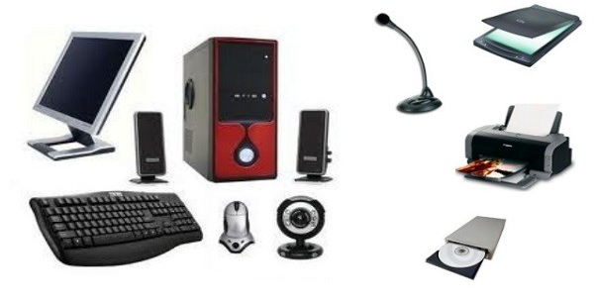
Hardware
Computer Hardware
Quite simply, computer hardware is the physical components that a computer system requires to function. It encompasses everything with a circuit board that operates within a PC or laptop; including the motherboard, graphics card, CPU (Central Processing Unit), ventilation fans, webcam, power supply, and so on.

Slide 38
Basics of Hardware and Software
Central Processing Unit (CPU)
Input Device
Output Device

